Slide 1
Data Analytics Jobs Portal
Team 6
Dristhi Yadav, Mark Levine, Richa Singh, Sicong Wang

Slide 2

Project Concept
Core concept :
To build a comprehensive and interactive resource for job seekers in the data science and analytics domain
Key Questions :
What are the key roles / opportunities available ?
Where are the opportunities concentrated geographically ?
Who are the primary employers/companies?
Data :
Data is drawn from 2 sources
Kaggle which is a compilation of 7,000 data scientist jobs, web scrapped from indeed website in August 2018 ("Kaggle.com" https://www.kaggle.com/sl6149/data-scientist-job-market-in-the-us)
Web scrapping from Glassdoor website supplements the Kaggle data with more recent postings and additional information on salary ranges (“Glassdoor.com”)

Slide 3
Approach
Kaggle CSV Formatting and Clean up
Web-scrapping for additional data
Data loading in Jupyter Notebook
Creating Database in Mongo.db
Creating App.py
Creating Index.html
Visualizations
Table.js
Charts.js
Maps.js

Slide 4
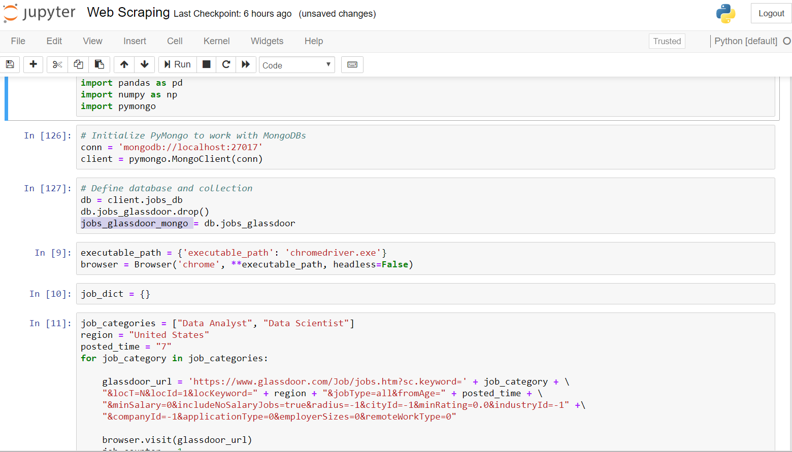
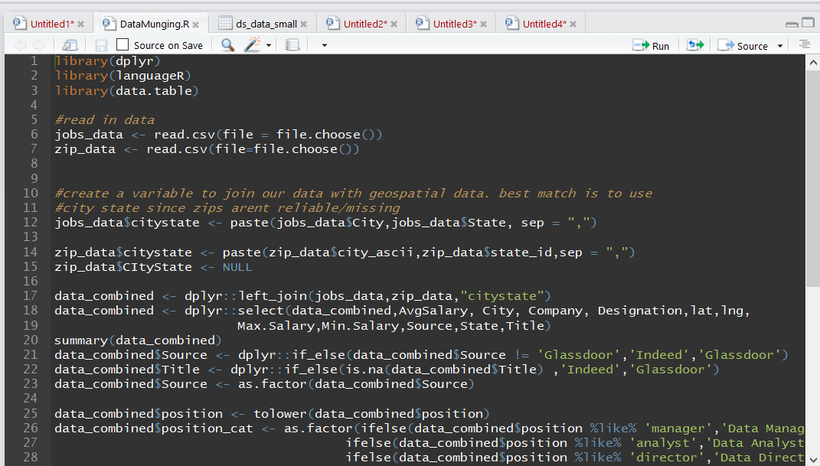
Data Setup & Clean Up

Slide 5
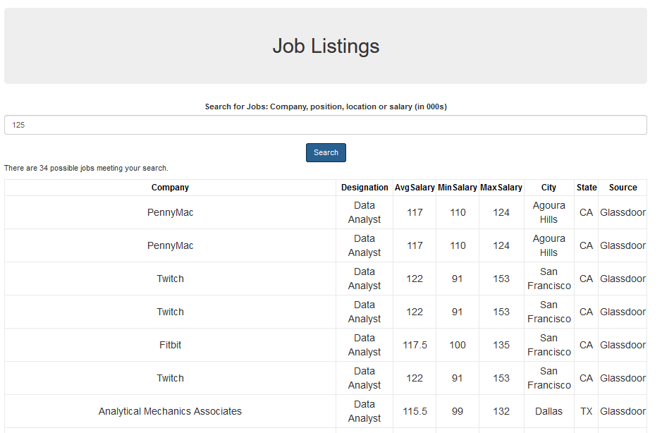
Visualizations - Table

Slide 6
Visualizations - Graphs

Slide 7
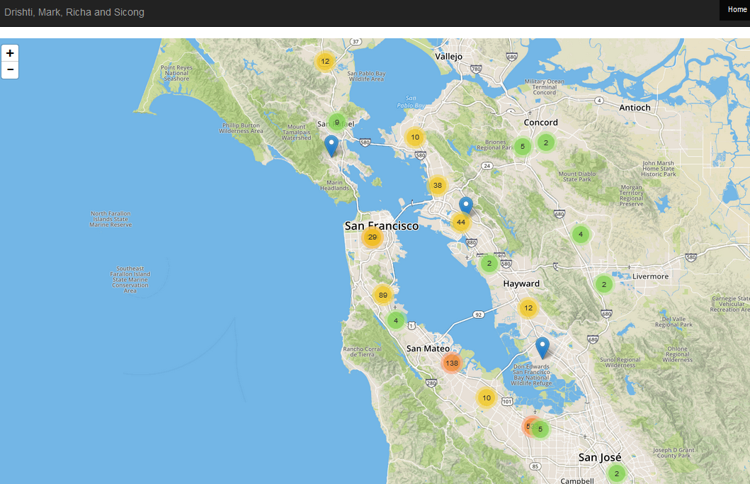
Visualizations - Map

Slide 8
Summary

Slide 9
Q & A

